Slide 1
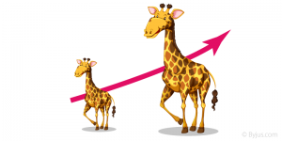
Direct Proportion
EQ: how can we tell if two things are in proportion?

Slide 2
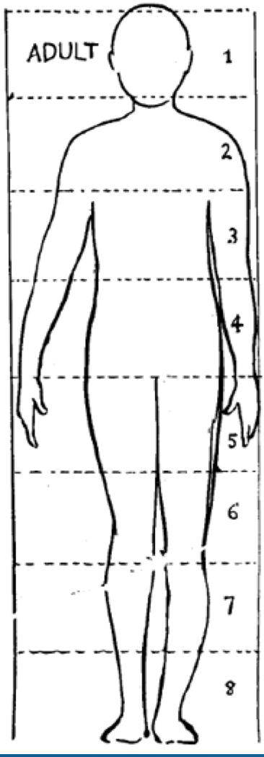
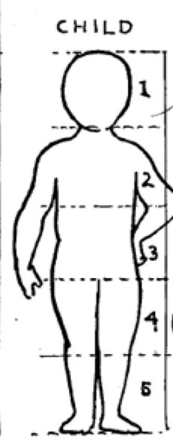
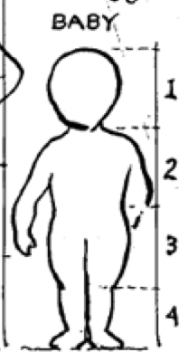
REAL WORLD PROPORTION
When drawing people, we can use proportion to help us get the shape right. The rule of thumb is an adult is 8 heads high, a child is 5 heads high and a baby is 4 heads high.
Michelle has drawn three figures;
figure 1 has a head of 3cm and a body of 24cm.
figure 2 has a head of 5cm and a body of 20cm.
figure 3 has a head of 4cm and a body of 20cm.
Which is the child, which is the adult and which is the baby?
3cm x 8 = 24cm Adult
5cm x 4 = 20cm Baby
4cm x5 = 20cm Child

Slide 3
Because Michelle's pictures are drawn as proportions, there is a ratio between the size of the head and the body length.
The Adult has a head to body ratio of 1:7
The Child has a head to body ratio of 1:4
The Baby has a ratio of head to body of 1:3

Slide 4
Topic : Proportion
24
7
30
Date
EQ : How do we know if 2 ratios are in proportion?
What is proportion?
When 2 ratios simplify to give the same ratio, they are said to be in proportion.
Eg 80km every 2h is proportionate to 240km every 6h
80:2 = 240:6
40:1 = 40:1
What is the easy way to check for proportionality?
1. First check the ratios are using the same units.
4kg cost $2 and 6000g is $3 because 6000g is 6kg These ratios become 4 kg:$2 = 6kg:$3
2. Divide the left portion by the right portion of each ratio
4/2 = 2 and 6/3 = 2.
3. If they both equal the same amount they are proportional
These can both be simplified to 40:1. They are equivalent to each other
How can we find out if they are in proportion?

Slide 5
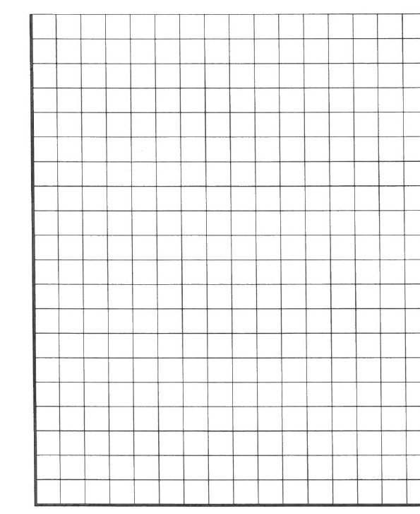
What does a graph of a proportional relationship look like?
$:Kg | $÷kg
4:2
8:4
10:5
$:Kg | $÷kg
6:2
10:4
12:5
$:Kg | $÷kg
2:2
8:4
15:5
$
18
17
16
15
14
13
12
11
10
9
8
7
6
5
4
3
2
1
0
$
18
17
16
15
14
13
12
11
10
9
8
7
6
5
4
3
2
1
0
$
18
17
16
15
14
13
12
11
10
9
8
7
6
5
4
3
2
1
0
1 2 3 4 5 6 Kg
1 2 3 4 5 6 Kg
1 2 3 4 5 6 Kg

Slide 6
What does a graph of a proportional relationship look like?
$:Kg | $÷kg
4:2 | 2
8:4 | 2
10:5 | 2
$:Kg | $÷kg
6:2
10:4
12:5
$:Kg | $÷kg
2:2
8:4
15:5
Proportional as $÷Kg gives the same answer each time
$
18
17
16
15
14
13
12
11
10
9
8
7
6
5
4
3
2
1
0
$
18
17
16
15
14
13
12
11
10
9
8
7
6
5
4
3
2
1
0
$
18
17
16
15
14
13
12
11
10
9
8
7
6
5
4
3
2
1
0
1 2 3 4 5 6 Kg
1 2 3 4 5 6 Kg
1 2 3 4 5 6 Kg

Slide 7
What does a graph of a proportional relationship look like?
$:Kg | $÷kg
4:2 | 2
8:4 | 2
10:5 | 2
$:Kg | $÷kg
6:2 | 3
10:4 | 2.5
12:5 | 2.4
$:Kg | $÷kg
2:2
8:4
15:5
Proportional as $÷Kg gives the same answer each time
Not Proportional as $÷Kg does not give the same answer each time
$
18
17
16
15
14
13
12
11
10
9
8
7
6
5
4
3
2
1
0
$
18
17
16
15
14
13
12
11
10
9
8
7
6
5
4
3
2
1
0
$
18
17
16
15
14
13
12
11
10
9
8
7
6
5
4
3
2
1
0
1 2 3 4 5 6 Kg
1 2 3 4 5 6 Kg
1 2 3 4 5 6 Kg

Slide 8
What does a graph of a proportional relationship look like?
$:Kg | $÷kg
4:2 | 2
8:4 | 2
10:5 | 2
$:Kg | $÷kg
6:2 | 3
10:4 | 2.5
12:5 | 2.4
$:Kg | $÷kg
2:2 | 1
8:4 | 2
15:5 | 3
Proportional as $÷Kg gives the same answer each time
Not Proportional as $÷Kg does not give the same answer each time
Not Proportional as $÷Kg does not give the same answer each time
$
18
17
16
15
14
13
12
11
10
9
8
7
6
5
4
3
2
1
0
$
18
17
16
15
14
13
12
11
10
9
8
7
6
5
4
3
2
1
0
$
18
17
16
15
14
13
12
11
10
9
8
7
6
5
4
3
2
1
0
1 2 3 4 5 6 Kg
1 2 3 4 5 6 Kg
1 2 3 4 5 6 Kg

Slide 9
What does a graph of a proportional relationship look like?
$:Kg | $÷kg
4:2 | 2
8:4 | 2
10:5 | 2
$:Kg | $÷kg
6:2 | 3
10:4 | 2.5
12:5 | 2.4
$:Kg | $÷kg
2:2 | 1
8:4 | 2
15:5 | 3
Proportional as $÷Kg gives the same answer each time
Not Proportional as $÷Kg does not give the same answer each time
Not Proportional as $÷Kg does not give the same answer each time
If ratios are graphed, they are proportional only if they form a straight line and go through the origin (point 0,0)
$
18
17
16
15
14
13
12
11
10
9
8
7
6
5
4
3
2
1
0
$
18
17
16
15
14
13
12
11
10
9
8
7
6
5
4
3
2
1
0
$
18
17
16
15
14
13
12
11
10
9
8
7
6
5
4
3
2
1
0
1 2 3 4 5 6 Kg
1 2 3 4 5 6 Kg
1 2 3 4 5 6 Kg

Slide 10
Are these in proportion?
1. Steve bought 3 Chocolates for $2 while Marie bought a packet of 12 for $8?
2. A pizza base recipe calls for 2 cups of flour to every 0.5L of water while a second recipe recommends 8 cups to every 2L of water?
3:2 12:8
3÷2 = 1.5 12÷8 = 1.5
Therefore these are in proportion
2:0.5 8:2
2÷0.5 = 4 8÷2 = 14
Therefore these are in proportion

Slide 11
3. Car one is travelling at 15m per second, car 2 is travelling at 60km per hour? Are the rates the same?
4. Mark gets paid $755 per week and Florence gets paid $1510 per fortnight? Are these equal?
15m:1second 60km:1hr
15m:1second 60000m:3600seconds
15÷1 = 15 60000÷3600= 16.7
Therefore these are NOT in proportion
755:1 1510:2
755÷1 = 755 1510÷2 = 755
Therefore these are in proportion

Slide 12
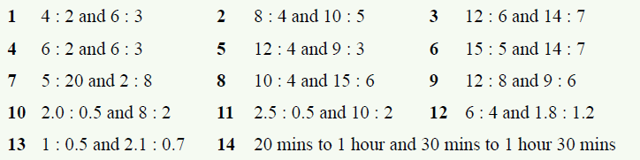
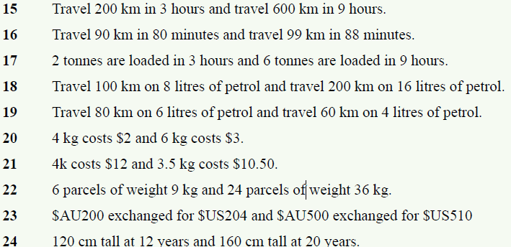
Complete Exercise 6.4 on page 76 to practice and Graph questions 1 to 9

Slide 13
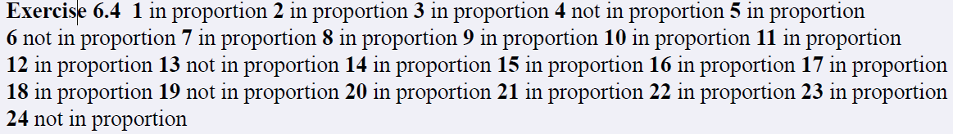
Answers to exercise 6.4

